Slide 1
Chapter 9
Responsive Web Design
with FlexBox

Slide 2
Objectives
Applied
Use FlexBox to lay out web pages or components within web pages, including the layouts for mobile devices.
Knowledge
Discuss how to apply FlexBox to page layout.
Explain these terms: flex box, flex item, main axis, cross axis, and flex direction.
Explain how the flex direction affects the way these alignment properties work: justify-content and align-items.

Slide 3
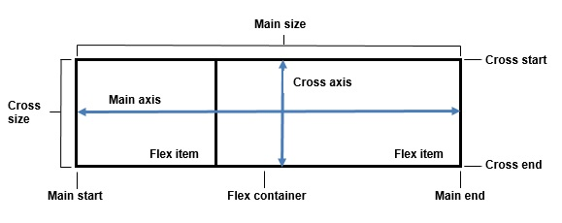
The flexible box layout

Slide 4

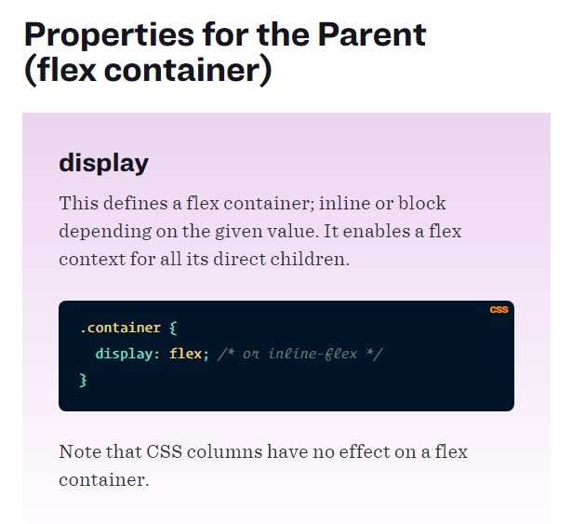
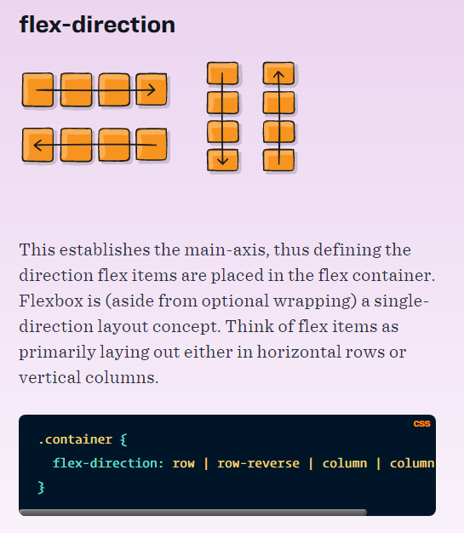
A navigation menu created using flexbox

Slide 5
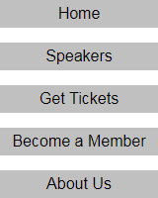
The HTML and CSS for a navigation menu
The HTML
<nav>
<ul>
<li><a href="index.html">Home</a></li>
<li><a href="speakers.html">Speakers</a></li>
<li><a href="tickets.html">Get Tickets</a></li>
<li><a href="member.html">Become a Member</a></li>
<li><a href="aboutus.html">About Us</a></li>
</ul>
</nav>
CSS that displays the menu vertically
ul {
display: flex;
flex-direction: column; list-style: none;
padding: 0;
margin: 0;
}

Slide 6
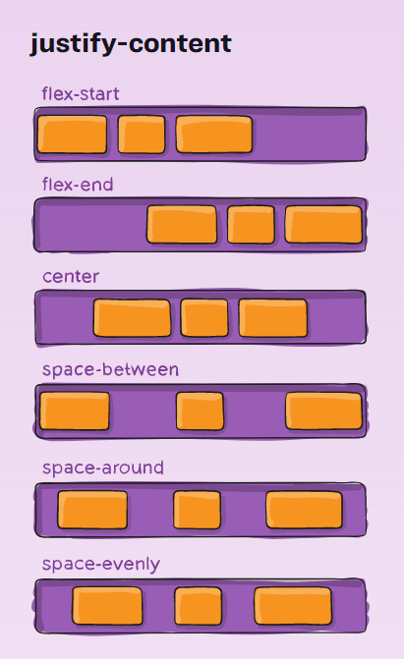

Slide 7
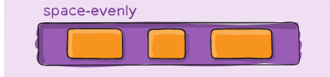
The CSS for a navigation menu with equal spacing
ul {
display: flex;
justify-content: space-evenly;
list-style: none;
padding: 0;
margin: 0;
}

Slide 8
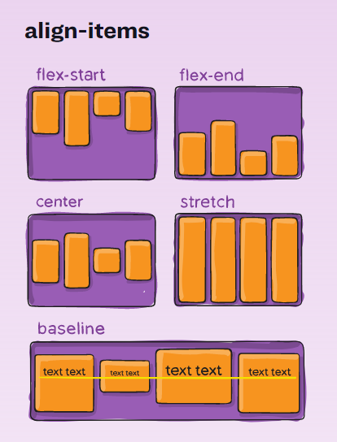
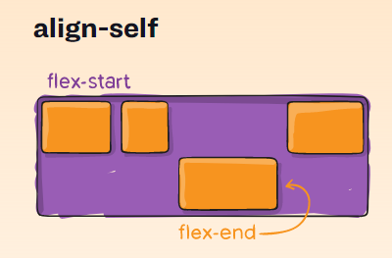

Slide 9
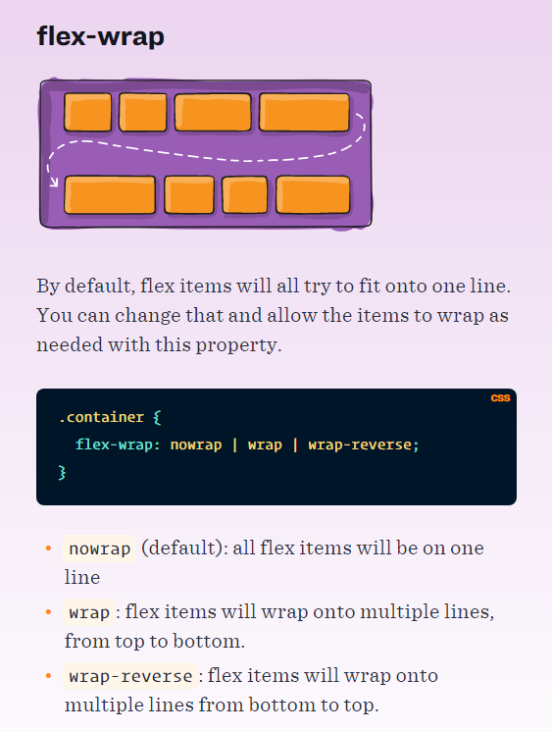
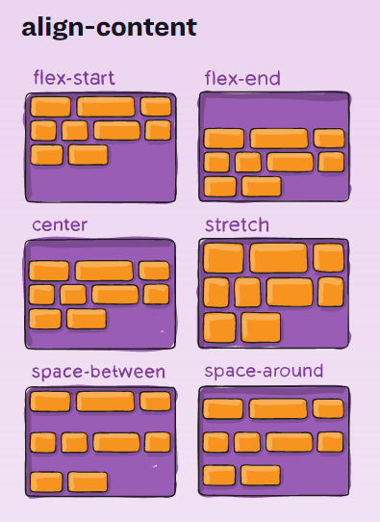

Slide 10
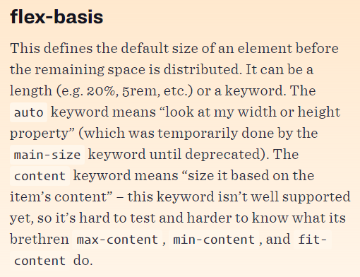
flex-basis
HTML
<main>
<nav>Navigation</nav>
<section>Content</section>
<aside>Sidebar</aside>
</main>
CSS
main { display: flex; }
nav, aside { flex-basis: 25%; }
section { flex-basis: 50%; }
The layout at 400 pixels wide
The layout at 800 pixels wide

Slide 11
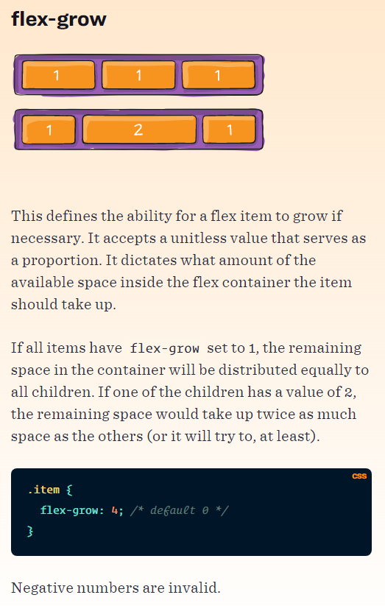
flex-grow
nav, aside {
flex-basis: 100px;
flex-grow: 1;
}
section {
flex-basis: 200px;
flex-grow: 3;
}
The layout at 400 pixels wide
The layout at 800 pixels wide

Slide 12
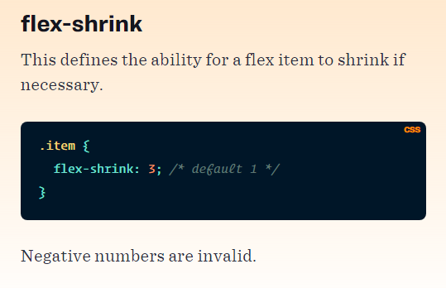
flex-shrink
nav, section, aside {
flex-basis: 250px;
}
nav {
flex-shrink: 0;
}
section, aside {
flex-shrink: 1;
}
The layout at 750 pixels wide
The layout at 500 pixels wide

Slide 13
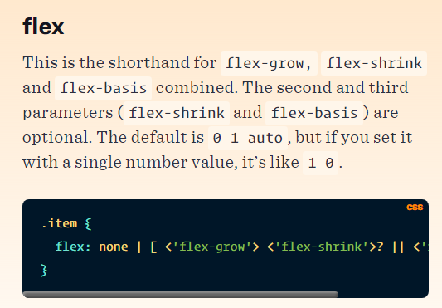

flex property shorthand (grow shrink basis)
nav, aside { flex: 1 1 100px; }
section { flex: 2 2 300px; }
The layout at 500 pixels wide
The layout at 750 pixels wide
The layout at 250 pixels wide

Slide 14
A simple page layout
<body>
<header><h3>Header</h3></header>
<main>
<aside><h3>Sidebar</h3></aside>
<section><h3>Section</h3></section>
</main>
<footer><h3>Footer</h3></footer>
</body>
A media query that changes the flex direction and reorders flex items
@media screen and (max-width: 760px) {
main { display: flex; flex-direction: column; }
section { order: 1; }
aside { order: 2; }
}

Slide 15
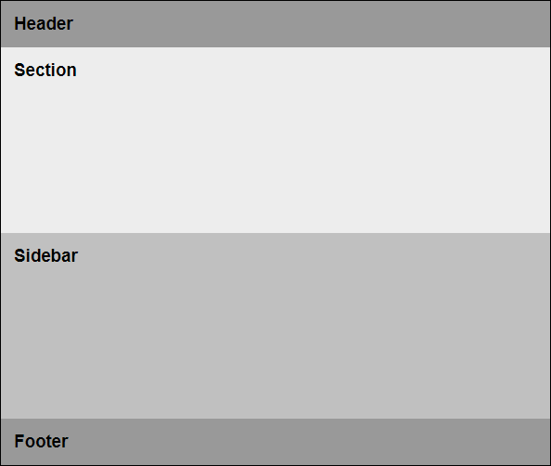
The page in a narrow viewport with the section and aside reordered

Slide 16
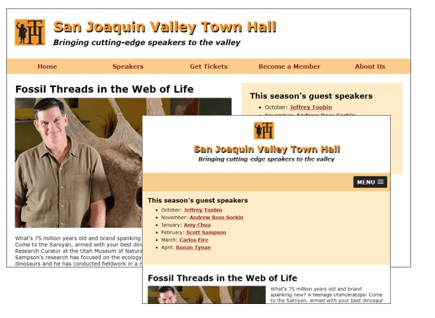
A speaker page in desktop and tablet layouts

Slide 17
The HTML for the structure of the page
<body>
<header>...</header>
<nav id="mobile_menu"></nav>
<nav id="nav_menu">
<ul>
<li><a href="index.html">Home</a></li>
...
</ul>
</nav>
<main>
<article>...</article>
<aside>
<nav>...
<ul>...</ul>
</nav>
</aside>
</main>
<footer>...</footer>
</body>

Slide 18
The primary CSS for desktop layout
#nav_menu ul {
display: flex;
flex-basis: 100%;
justify-content: space-around; }
#nav_menu ul li {
flex-basis: 20%; }
main {
display: flex; }
article {
flex-basis: 60%;
margin: 1.5em 2.52525% 0 2.0202%; }
aside {
flex-basis: 40%;
max-height: 200px;
min-height: 180px;
padding: 2.0202%;
background-color: #ffebc6;
margin: 1.5em 2.0202% 0 0;
}

Slide 19
The CSS for mobile landscape to tablet portrait
@media only screen and (max-width: 767px) {
header {
display: flex;
flex-direction: column;
align-items: center;
}
header img {
float: none;
flex-basis: 25%;
}
main {
flex-direction: column;
}
article {
order: 2;
}
aside {
order: 1;
margin: 0;
}
}

Slide 20
The CSS for mobile portrait to mobile landscape
@media only screen and (max-width: 479px) {
article img {
float: none;
width: 100%;
margin-right: 0;
}

Slide 21
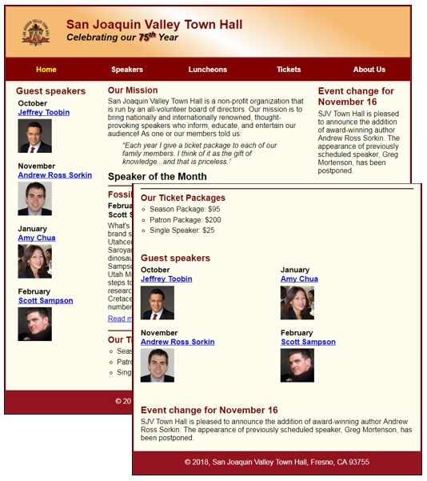
Short 9-1 Use flexbox to add a third column to the Town Hall home page

Slide 22
Summary
display: flex
flex-direction: row or column
flex-wrap: nowrap or wrap
justify-content: flex-start, center, flex-end, stretch, space-between, space-around, space-evenly
align-items: stretch, center, flex-start, flex-end, baseline
align-content: stretch, center, flex-start, flex-end, space-between, space-around
flex-basis: measurement
flex-grow: number (default 0)
flex-shrink: number (default 1)
order: number

Slide 23
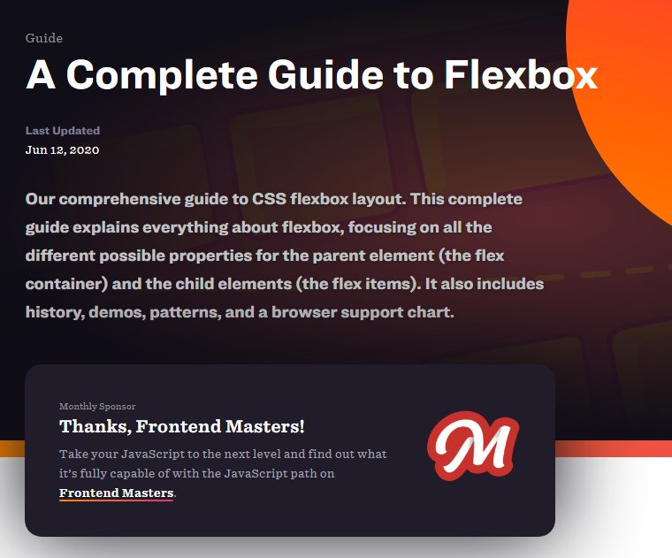
A Complete Guide to Flexbox
https://css-tricks.com/snippets/css/a-guide-to-flexbox/

Slide 24
Objectives
Applied
Use FlexBox to lay out web pages or components within web pages, including the layouts for mobile devices.
Knowledge
Discuss how to apply FlexBox to page layout.
Explain these terms: flex box, flex item, main axis, cross axis, and flex direction.
Explain how the flex direction affects the way these alignment properties work: justify-content and align-items.

Slide 25
Assignments
Reading assignments on Perusall
Homework and Labs on InsideRanken

